Slide 1
Meet The Teacher
PAGE BREAK / TITLE PAGE
Date: September 2023 Name: Mrs Bramwell
Class: Year 6

Slide 2
General Information
Mrs Bramwell- Class Teacher
Mrs Thripland / Miss James- Teaching Assistant
Mr Hammond (PE) and Mr Gibbon (Music)
Naming items - Dictionary & thesaurus, all clothing, water bottles

Slide 3
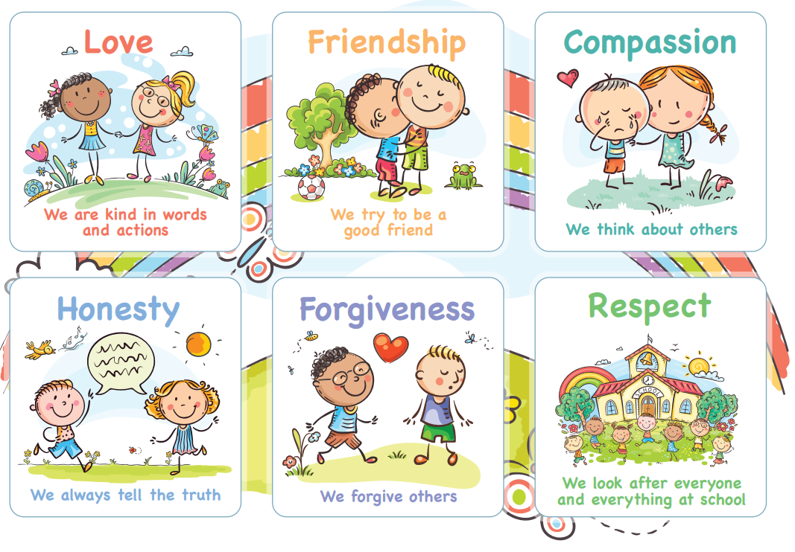
Behaviour for Learning
A Growth Mindset – independent attitude and ability to learn from self and others. Challenge oneself. Inspire others. Motivated and Motivator. Role model. Be resilient.
Rewards & Celebrations
Celebration Certificates
Values bands
Positive praise and encouragement

Slide 4
Responsibility and GREATER Independence
High expectations throughout the school – especially in Year 6
• Class specific roles and responsibilities – House Captains, Class Councillors, Eco Councillor and Collective Worship Monitors, Librarians
• Transition - ready for Year 7

Slide 5
Reading
Books – from home and/or school
Reading routines – Minimum 4/7 and Qs from parents/carers for greater dive and inference.
Parent/carer sign the Reading Record Book
Reading is both decoding and comprehension
Importance of reading for pleasure
Variety of genre and forms
If a child is stuck: I read/You read (‘I read, we read, you read’ – KS1 & LKS2).
School reading practises – Guided Reading sessions, 1:1 reading support where appropriate

Slide 6
Guided Reading
Scaffolded talk about a text, in a small group setting
Develops deeper comprehension strategies
Teachers model, then help students to guide group discussions using four strategies: summarising, predicting, clarity of unknown words and creating questions that dig deeper into the book (inference)

Slide 7
Home Learning
Expectations and purpose
Responsibility, accountability, organisation, meeting deadlines – all transition-ready work
Tasks link with specific topics
Online platforms – please ensure safety online (eg; Tik Tok)
Pick ‘n’ Mix Home learning (presentation is important)
Home learning is celebrated & shared, home learning gallery
TTRockstars – children must know all of their times tables

Slide 8
Assessments
Continual teacher assessment throughout the year
Reading, Writing and Maths assessments, Autumn, Spring and Summer Term
Maths assessments following maths units

Slide 9
Communication
Informal conversations after school, please avoid before school
Message, phone or email via school office: office@marshgibbon.bucks.sch.uk
01869 277 268
Please do not use Class Dojo for messaging school/staff - this is not monitored.

Slide 10
Appointments 11th / 12th September
Only for parents who wish to share anything formally and urgently with myself in a private setting please let me know at the end of this meeting
Staff will not be sharing information about children as it is too early in the term.
Learning Discussions will be in November ‘23 to share progress and assessments for the Autumn term, and share priorities for the Spring term.

Slide 11
80 / 20

Slide 12
Thank you for your support.
Any questions?

