Slide 1
Meet The Teacher
PAGE BREAK / TITLE PAGE
Date: September 2023 Name: Mrs Martin and Mrs Williams
Class: Year 5

Slide 2
General Information
Mrs Martin (Mon/Tues) & Mrs Williams (Wed, Thurs, Fri) - Class Teachers
Mrs James / Mrs Thripland- Teaching Assistant
Mr Hammond (PE Monday and Thursday) and Mrs Freeman (Music)
Naming items - Dictionary & thesaurus, all clothing, water bottles, pencil cases

Slide 3
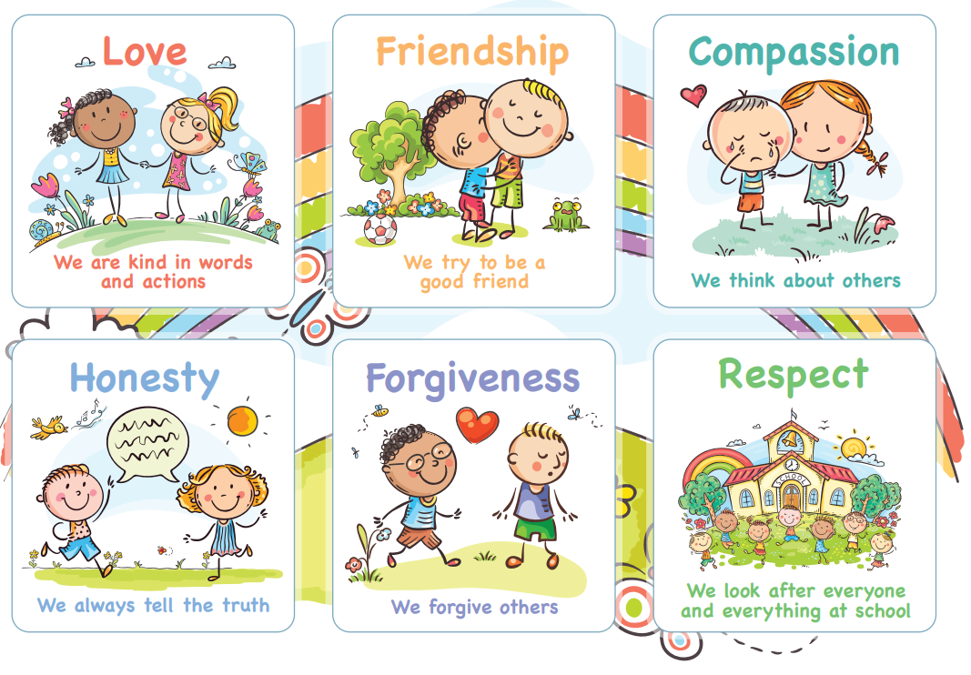
Behaviour for Learning
A Growth Mindset – independent attitude and ability to learn from self and others. Challenge oneself. Inspire others. Motivated and Motivator. Role model. Be resilient.
Rewards & Celebrations
Celebration Certificates
Values bands
Positive praise and encouragement

Slide 4
Responsibility and Independence
High expectations throughout the school
• Expectations set early in year to support independence
• Early morning tasks - activities set each morning as
children arrive (important to be prompt, ready for learning)
• Completion of home learning tasks
• Opportunities for School Council/ Eco Council

Slide 5
Reading
• Children are expected to read at least 4x p.wk
• All children have a book on their tables at all times (from home or class
collection)
• Reading is both decoding and comprehension
• Importance of reading for pleasure / adults to model reading
• Variety of genre and forms • ‘I read, we read, you read’ model can be
adapted for KS2

Slide 6
Guided Reading
Guided reading is a structured approach to teaching strategies that children can use to improve their reading comprehension.
Teachers model, then help students to work independently on the four strategies: summarising, predicting, learning unknown words and creating questions that dig deeper into the book (inference)
One session a week is a teacher focus group where children are encouraged to share their independent work and challenge each other

Slide 7
Home Learning
Pick and Mix sheet sent home each half term - includes a range of activities which generally link with current topics in class
Purpose- encourages responsibility, organisation, meeting deadlines, communication
Can be posted on Class Dojo or Google classroom
If the completed task is being brought into class to share no need to also post a photograph
All home learning is celebrated and shared
Children expected to read at least 5x pwk. Please sign each time your child reads. Bring Reading record into school every Friday to be checked.
Times tables for quick recall – all times tables need to be learnt.

Slide 8
Assessments
Continual teacher assessment throughout the year
PIRA (Reading) and PUMA (Maths) tests at the end of each term
Daily times tables work to support recall

Slide 9
Communication
Informal conversations after school, please avoid before school
Please chat / ask questions
Message, phone or email via school office: office@marshgibbon.bucks.sch.uk
01869 277 268
Please do not use Class Dojo for messaging school/staff - this is not monitored.

Slide 10
1:1 Appointments 11th/12th September
Only for parents who wish to share anything formally and urgently with ourselves in a private setting please make an appointment.
Staff will not be sharing information about children as it is too early in the term.
Learning Discussions will be in November ‘23 to share progress and assessments for the Autumn term, and share priorities for the Spring term.

Slide 11
80 / 20

Slide 12
Thank you for your support.
Any questions?

