Slide 1
Meet The Teacher
PAGE BREAK / TITLE PAGE
Date: September 2023 Name: Miss Trafford
Class: Year 4

Slide 2
General Information
Miss Trafford - Class Teachers
Mrs Riley/Ms James/Mrs Thripland - Teaching Assistant
Mr Hammond (PE - Wednesdays and Fridays) and Mrs Freeman (Music - Fridays)
Naming items – All clothing, water bottles
Learning opportunities alongside Year 3

Slide 3
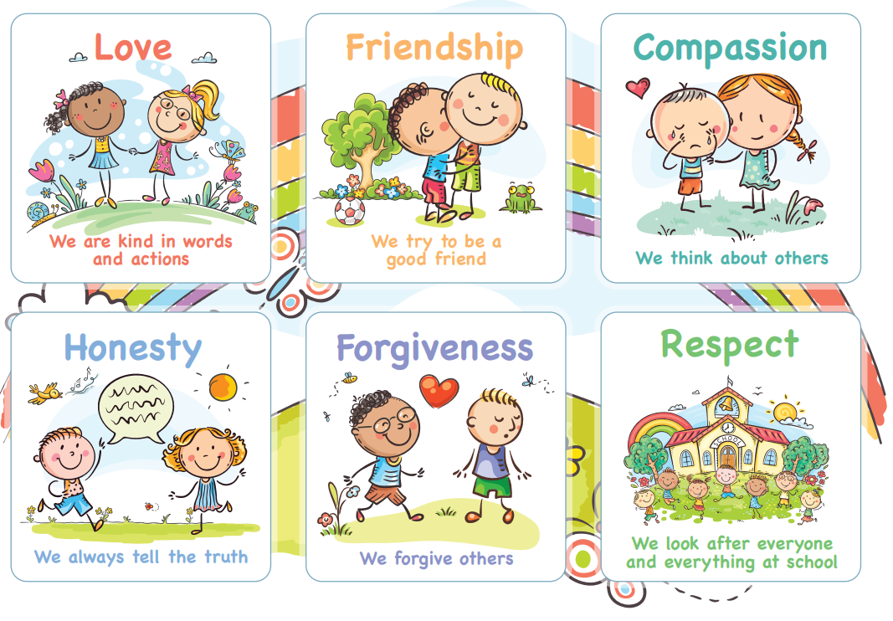
Behaviour for Learning
A Growth Mindset – independent attitude and ability to learn from self and others. Challenge oneself. Inspire others. Motivated and Motivator. Role model. Be resilient.
Rewards & Celebrations
Celebration Certificates
Values bands
Positive praise and encouragement

Slide 4
Responsibility and Independence
High expectations throughout the school
Expectations set early in year to support independence
Class specific responsibilities
Eco Council & School Council
More independence for personal belongings
Taking responsibility for their learning
Being a role model to younger children

Slide 5
Reading
Books & reading routines - books from home/school, ERIC daily, must be reading 4/7 days per week at home
Reading records checked on Fridays
When children are free readers, they can change their reading books when they finish and this will be their responsibility in order to promote independence
Reading is both decoding and comprehension
Importance of reading for pleasure - variety of genre and forms
‘I read, we read, you read’ if unable to read a word

Slide 6
Guided Reading
Scaffolded talk about a text, in a small group setting, that develops comprehension strategies.
Teachers model, then help students to guide group discussions using four strategies: summarising, predicting, learning unknown words and creating questions that dig deeper into the book (inference)
VIPERS - vocabulary, infer, predict, explain, retrieve, summarise

Slide 7
Home Learning
Pick and Mix sheet sent home each half term - includes a range of activities which generally link with current topics in class
Purpose - encourages responsibility, organisation, meeting deadlines, communication
Can be posted on Class Dojo or Google classroom (if the completed task is being brought into class to share no need to also post a photograph)
All home learning is celebrated and shared - at the end of each half term in our Home Learning Galleries (first one: 20th October 2023)
4 home learning tasks to be completed per half term
Children expected to read at least 4 x pwk. Please sign each time your child reads. Bring Reading record into school every Friday to be checked.
Times tables practice - TTRS - for quick recall – to know all times tables by end of Year 4

Slide 8
Assessments
Continual teacher assessment throughout the year
End of unit maths assessments
PIRA (Reading) and PUMA (Maths) tests at the end of each term
Times Tables Multiplication Check June ’24

Slide 9
Communication
Informal conversations after school
Please chat / ask questions
Message, phone or email via school office: office@marshgibbon.bucks.sch.uk
01869 277 268
Please do not use Class Dojo for messaging school/staff - this is not monitored.

Slide 10
1:1 Appointments 11th & 12th September
Only for parents who wish to share anything formally and urgently with myself in a private setting please let me know at the end of this meeting
We will not be sharing information about children as it is too early in the term.
Learning Discussions will be in November ‘23 to share progress and assessments for the Autumn term, and share priorities for the Spring term.

Slide 11
80 / 20

Slide 12
Thank you for your support.
Any questions?

