Slide 1
Meet The Teacher
PAGE BREAK / TITLE PAGE
Date: September 2023 Name: Mrs Underwood
Class: Year 3

Slide 2
General Information
Mrs. Underwood- Class Teacher
Mrs. Martin - Wednesday
Mrs. Riley/ Mrs. James/ Mrs. Thripland - Teaching Assistant
Mr. Hammond (PE) and Mr. Gibbon (Music)
Naming items – All clothing, water bottles
Learning opportunities alongside Year 4

Slide 3
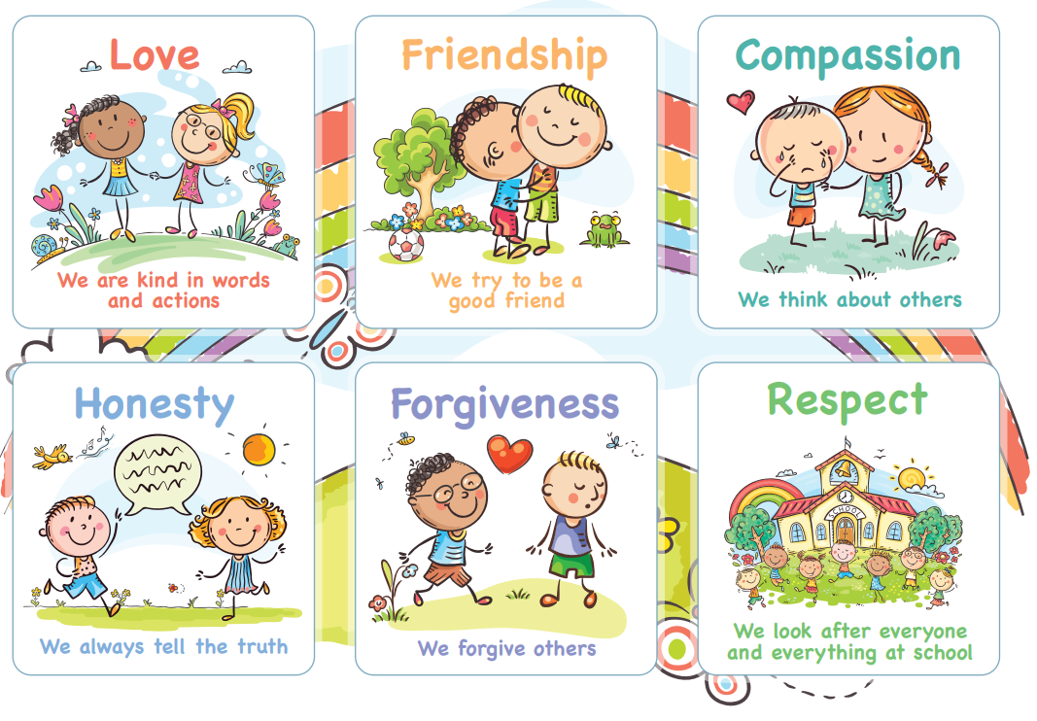
Behaviour for Learning
A Growth Mindset – independent attitude and ability to learn from self and others. Challenge oneself. Inspire others. Motivated and Motivator. Role model. Be resilient.
Rewards & Celebrations
Celebration Certificates
Values bands
Positive praise and encouragement

Slide 4
Responsibility and Independence
High expectations throughout the school
Expectations set early in year to support independence
Class specific responsibilities
Eco Council/ Student Council
More independence for personal belongings
Taking responsibility for their learning
Being a role model to younger children now they are in KS2.

Slide 5
Reading
Book & reading routines:
Reading records checked weekly. Expectation is 4 weekly home reads and the reading record signed by an adult
Reading is both decoding and comprehension.
Importance of reading for pleasure • Variety of genre and forms • ‘I read, we read, you read’

Slide 6
Guided Reading
Scaffolded talk about a text, in a small group setting, that develops comprehension strategies
Completed with the teacher (LKS2) but in UKS2 it is more independent of the teacher
Teachers model, then help students to guide group discussions using four strategies: summarising, predicting, learning unknown words and creating questions that dig deeper into the book (inference)
VIPERS - vocabulary, infer, predict, explain, retrieve, summarise

Slide 7
Home Learning
Purpose- encourages responsibility, organisation, meeting deadlines, communication
Pick and Mix sheet sent home each half term - includes a range of activities which generally link with current topics in class
Can be posted on Class Dojo or Google classroom
If the completed task is being brought into class to share no need to also post a photograph
All home learning is celebrated and shared
Reading records in school every day – checked on a Friday
Children expected to read at least 4x pwk.
TT Rockstars for times tables quick recall.

Slide 8
Assessments
Continual teacher assessment throughout the year
PIRA (Reading) and PUMA (MATHS) tests at the end of each term
Daily times tables work to support recall 2,5,10 3,4,8 then the rest

Slide 9
Communication
Informal conversations after school, please avoid before school
Please chat / ask questions
Message, phone or email via school office: office@marshgibbon.bucks.sch.uk
01869 277 268
Please do not use Class Dojo for messaging school/staff - this is not monitored.

Slide 10
1:1 Appointments 11th & 12th September
For parents who wish to share anything formally and urgently with myself in a private setting please make an appointment after this meeting.
Staff will not be sharing information about children as it is too early in the term.
Learning Discussions will be in November ‘23 to share progress and assessments for the Autumn term, and share priorities for the Spring term.

Slide 11
80 / 20

Slide 12
Thank you for your support.
Any questions?

