Slide 1
Healthy Minds
‘Changing Me’
RSE curriculum
June 2023

Slide 2
Aims:
To share with you what is taught and why
To reassure you that our programme of study is comprehensive and purposeful
To discuss strategies to help support your child’s learning
Provide a space for your thoughts, worries and concerns

Slide 3
The purpose
The purpose of RSE is to provide knowledge and understanding of how the human body changes during puberty, and the processes of human reproduction, within the context of relationships based on love and respect.
Relationships and Sex Education- the relationships part is the focus at Primary School.

Slide 4
How is it taught?
Our PSHE (or Healthy Minds) curriculum covers-
Health Education (statutory) some crossover with science
Relationships Education (statutory)
Living in the wider world (Economic well-being, careers and enterprise education, and personal safety) Not yet statutory but considered best practice
and
Sex education (not statutory until KS3 but DfE recommends)
You can legally withdraw your child from sex education lessons, but not Health Education, Relationships Education or Science lessons (which cover puberty)

Slide 5
The DfE guidance
‘It is important that the transition phase before moving to secondary school supports pupils’ ongoing emotional and physical development effectively.
The DfE recommends
that all primary schools have a sex education programme tailored to the age and physical and emotional maturity of the pupils. It should ensure that both boys and girls are prepared for the changes that adolescence brings and-drawing on knowledge of the human life cycle set out in the national curriculum for Science-how a baby is conceived and born’.

Slide 6
Whole school Jigsaw scheme of learning
Jigsaw is a progressive and spiral scheme of learning which ensures that learning from previous years is revisited and extended, adding new concepts, knowledge and skills, year on year, as appropriate.
Autumn 1 Being me in my world
Autumn 2 Celebrating difference
Spring 1 Dreams and goals
Spring 2 Healthy Me
Summer 1 Relationships
Summer 2 Changing me

Slide 7
Changing me
Sensitive content begins at Y4 so that children are prepared for changes that might happen to them and their bodies. We share the year group unit overviews (with key vocab used) so that parents have the opportunity to discuss anything they wish with their children prior to the teaching, or to answer questions that might arise from their children after the teaching.
Year 4-Puberty and Periods
Year 5-Puberty, periods and conception
Year 6 -Puberty, conception, mutual respect and consent
This year the current Y6 will be taught sessions from the Y4 Y5 and Y6 units otherwise they will miss out on some vital teaching content.

Slide 8
Y5 and Y6 lessons
Taught by class teachers, boys and girls together (all need to know everything)
Question box
Age appropriate
Handled sensitively, taught by class teachers as they already have a trusted relationship

Slide 9
Y5 content
The year 5 children will have a weekly lesson covering the following areas:
Week 1 - Self and body image
LI: I am aware of my own self-image and how my body image fits into that. I know how to develop my own self esteem
Week 2 - Puberty for girls
LI: I can explain how a girl’s body changes during puberty and understand the importance of looking after yourself physically and emotionally. I understand that puberty is a natural process that happens to everybody and that it will be ok for me.
Week 3 - Puberty for boys
LI: I can describe how boys’ and girls’ bodies change during puberty. I can express how I feel about the changes that will happen to me during puberty.
Week 4 - Conception
LI: I understand that sexual intercourse can lead to conception and that is how babies are usually made. I also understand that sometimes people need IVF to help them have a baby. I appreciate how amazing it is that human bodies can reproduce in these ways,
Week 5 - Looking ahead 1
LI: I can identify what I am looking forward to about becoming a teenager and understand this brings browning responsibilities (age of consent). I am confident that I can cope with the changes that growing up will bring.
Week 6 - Looking ahead 2
LI: I can identify what I am looking forward to when I move to my next class. I can start to think about changes I will make next year and know how to go about this.

Slide 12
Y6 content
Session 1 - My self image
LO: To be aware of my own self-image and how my body image fits into that
Session 2 - Puberty
LO: To explain how girls’ and boys’ bodies change during puberty and understand the importance of looking after yourself physically and emotionally. To know how to develop my own self esteem. I can express how I feel about the changes that will happen to me during puberty.
Session 3 - Babies: Conception to Birth
LO: To describe how a baby develops from conception through the nine months of pregnancy, and how it is born. To recognise how I feel when I reflect on the development and birth of a baby.
Session 4 - Boyfriends and girlfriends.
LO: To understand how being physically attracted to someone changes the nature of the relationship and what that might mean about having a girlfriend/boyfriend. To understand that respect for one another is essential in a boyfriend/girlfriend relationship, and that I should not feel pressured into doing something I don’t want to.
Session 5 - Real self and ideal self
LO: To be aware of the importance of a positive self-esteem and what I can do to develop it. To express how I feel about my self-image and know how to challenge negative ‘body-talk’.
Session 6 - The Year Ahead
LO: To identify what I am looking forward to and what worries me about the transition to secondary school /or moving to my next class. To know know how to prepare myself emotionally for the changes next year.

Slide 13
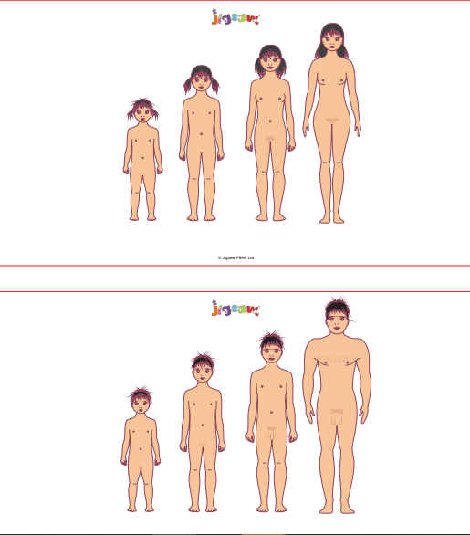

Slide 14
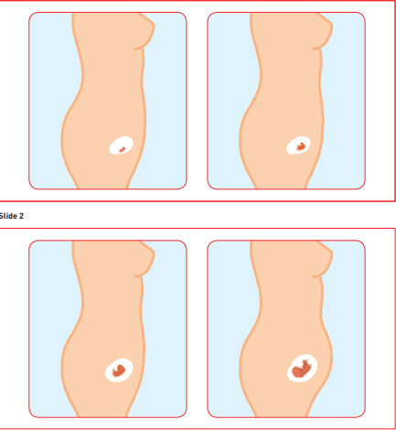

Slide 15
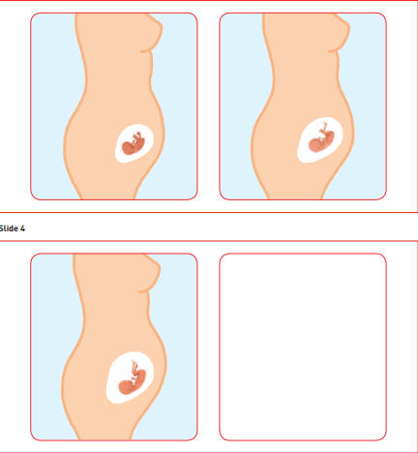

Slide 16
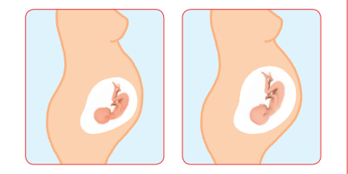

Slide 17
Any questions?

