Slide 1
Maths at Marsh Gibbon
A Mastery Approach

Slide 2
Aims of this morning:
To introduce the Mastery approach
To share how the Mastery approach supports our teaching
To share how the calculation policy is implemented across the school.

Slide 3
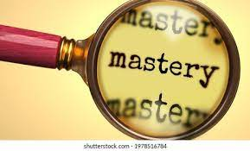
What does ‘Mastery’ Mean?
Not just with our maths, but in general, ‘mastery’ means:
To be extremely skilled at a topic or activity
To be secure with a key concept or topic
To show proficiency in a given area

Slide 4
Why do we use a mastery approach?
Children are able to independently apply their knowledge to a range of increasingly complex problems.
Children are reasoning with increased confidence and accuracy
Children are confident in their own learning and actively participate in mathematical discussions showing an understanding and enjoyment of maths.

Slide 5
National Curriculum Aims
The mastery approach directly supports the National Curriculum aims. In their simplest terms these are;
Become fluent in the fundamentals of Maths
Reason mathematically
Solve problems

Slide 6
What Does ‘Mastery Maths’ Look Like?
Pupils are taught through whole-class interactive teaching, securing the concepts necessary for the next part of the curriculum sequence.
In a typical lesson, the teacher leads back and forth interaction, including questioning, short tasks, explanation, demonstration, and discussion, enabling pupils to think, reason and apply their knowledge to solve questions or problems.
Use of precise mathematical language enables all pupils to communicate their answers.
If a pupil fails to grasp a concept, this is identified quickly, and gaps in understanding are addressed to prevent them falling behind.
Key number facts are learnt and practised regularly, to avoid cognitive overload and enable pupils to focus on new learning.

Slide 7
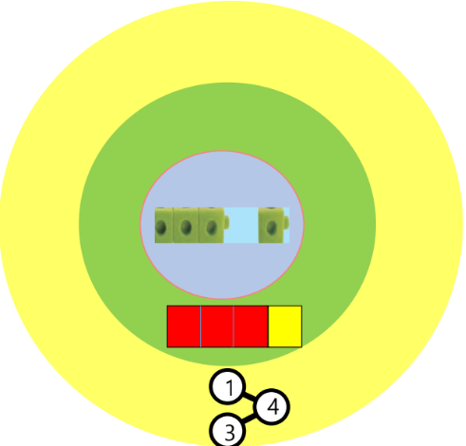
CPA Approach
The mastery approach is based around Concrete, Pictorial, Abstract teaching approach.
Through this stepped approach children develop their confidence and understanding with calculations.
But what does it mean?

Slide 8
Concrete Stage
Concrete is the ‘doing stage’. During this stage, children use concrete objects to model problems.
Unlike traditional maths teaching methods where teachers demonstrate how to solve a problem, the CPA approach brings concepts to life by allowing children to experience and handle physical objects.For example, if a problem involves adding paintbrushes, children can first handle paint brushes.

Slide 9
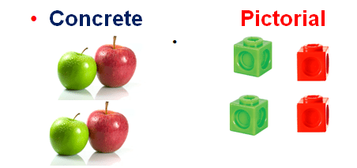
Pictorial Stage
Pictorial is the ‘seeing’ stage. Here, visual representations of concrete objects are used to model problems. This stage encourages children to make a mental connection between the physical object they just handled and the abstract pictures, diagrams or models that represent the objects from the problem.
Building or drawing a model makes it easier for children to grasp difficult abstract concepts e.g. fractions.
Simply put, it helps the children
visualise abstract problems and
makes them more accessible

Slide 10
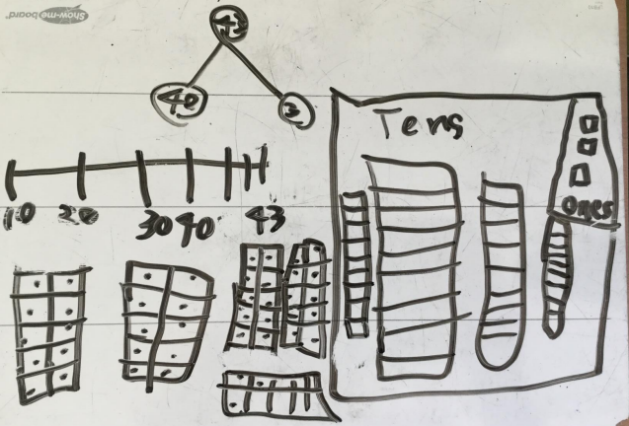

Slide 11
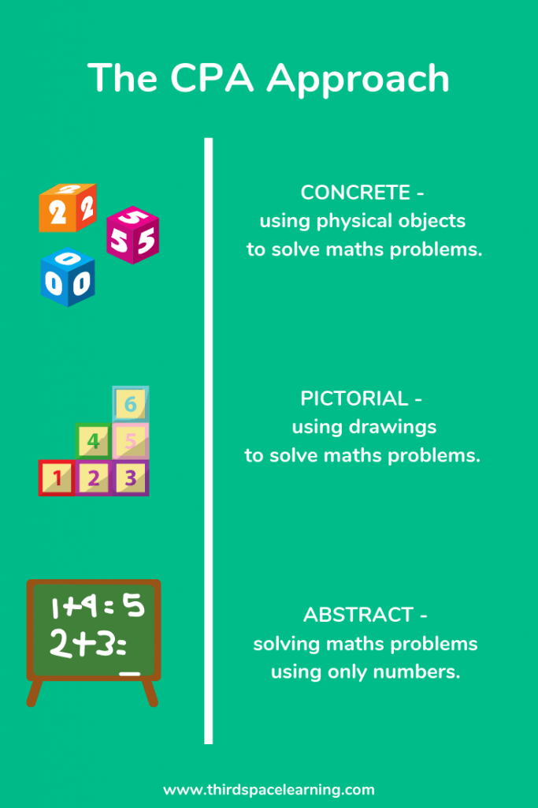
Abstract
Abstract is the ‘symbolic’ stage, where children use abstract symbols and numbers to model problems. E.g. +, -, x, ÷ to indicate addition, subtraction, multiplication or division or the numerator and denominator of a fraction.

Slide 12
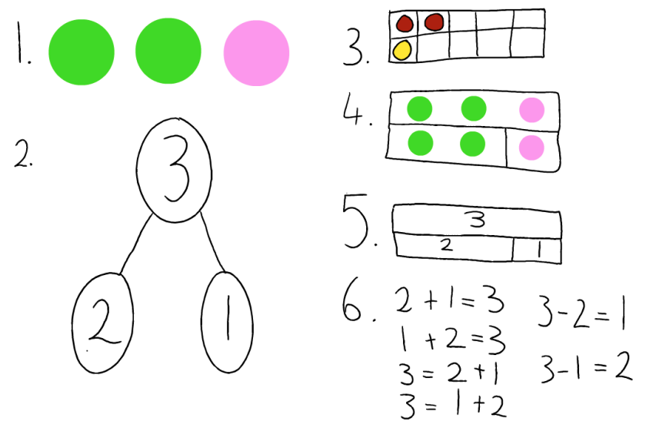

Slide 13
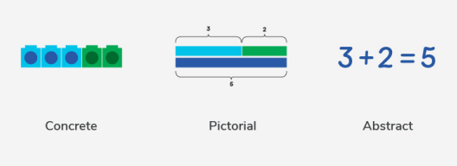

Slide 14
Calculation Policy
This CPA is applied throughout our calculation policy to the ways we teach the children to calculate in lessons.
The children should be secure with a method before introducing the next step.
Here are some examples of how it can be applied:

Slide 16
Subtracting with exchanging:

Slide 17
Multiplication:

Slide 18
Division:

Slide 19
Supporting our Maths Lessons with Fluency
What is Fluency?
Fluency involves...
Quick recall of facts and procedures - number sense
The flexibility to move between different contexts
The ability to recognise relationships/structures and make connections in mathematics
Fluency allows children to do richer, deeper mathematics: reasoning, problem-solving, spotting patterns and making connections.

Slide 20
If a pupil knows these facts, they will then be able to start making deeper connections for example: 8 × 6:
the same as 6 × 8
Double 4 x 6
0.8 x 6
80 x 6
80 x 60, etc.
A word problem such as: ‘how many books are in a bookcase with 8 shelves and 6 books on each shelf?’

Slide 21
Fluency Teaching
In school, all classes have fluency sessions in addition to their maths lessons most days.
These focus on times tables but also on counting patterns including decimals and negative numbers, addition and subtraction strategies and securing number bonds to 10, 20, 100 and 1,000.
This is why we place such a high importance on the children completing weekly TT Rock Stars sessions.

Slide 22
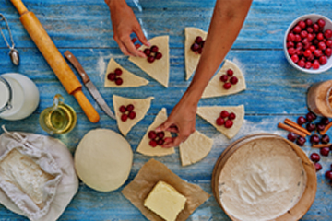
How can you help at home?
Growth mindset - modelling the I can’t do this YET approach
Practise maths in a fun way and talk positively about maths at home
Support times table practice
Encourage number sense - counting,
number bonds, number patterns,
counting out change, measuring, etc.

Slide 23
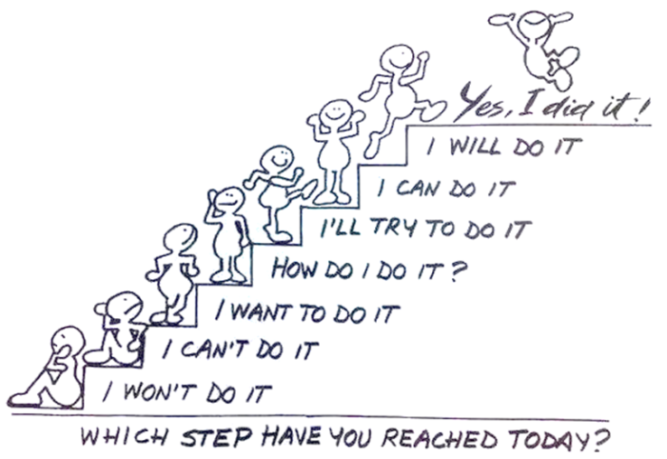
Mindset

